Slide 1
WEEK 2
Intermediate Java
&
Android
By
Shams Al Ajrawi

Slide 2
Agenda
Classes
Arrays
INHERITANCE
Polymorphism
Intro to Android

Slide 3
A First Look at Classes
Objects and Classes
Writing a Simple Class, Step by Step
Instance Fields and Methods
Constructors
Passing Objects as Arguments
Overloading Methods and Constructors
Scope of Instance Fields
Packages and import Statements
Focus on Object-Oriented Design: Finding the Classes and Their Responsibilities

Slide 4
Objects and Classes
•Objects have two general capabilities:
    Store data (fields)
    Perform operations (methods)
-Classes
Blueprint/Template for objects
•Instance of a class - Object created from a class
•Java API (Application Programming Interface) provides many pre-written classes
e.g. Scanner, String, File, PrintWriter, JOptionPane

Slide 5
Writing a Simple Class, Step by Step
Constructor - method that is used to perform operations at the time an object is created
-typically initializes instance fields
Class Member - Field or Method
Access Specifiers - public - the member can be accessed
inside the class or outside
private - the member can be accessed inside the
class but cannot be accessed outside the class
Data Hiding - Declaring instance fields as private, only accessing fields through methods

Slide 6
  Instance Fields and Methods
instance fields - fields that belong to an object of the class
instance methods - methods that can be called on an object of the class
wins, losses, winningPercentage are instance fields. They belong to a particular instance of the Team class (i.e. cubs).

Slide 7
  Constructors
Constructor - Method used to perform operations on a newly created object
If you do not write a constuctor, Java provides one when the class is compiled. This is known as the default constructor
Default Constructor
Numeric Fields | 0
boolean | false
Reference Variables | null

Slide 8
Team.Java
/*
To change this license header, choose License Headers in Project Properties.
To change this template file, choose Tools | Templates
and open the template in the editor.
*/
package worldseries;
/**
*
@author student
*/
public class Team
{
//These are the fields. private int wins; private int losses; private String name;
//private double winningPercentage;
//This is a constructor.
/*public Team(String n, int w, int l){
name = n; wins = w; losses = l;
}
*/
public String getName(){
return name;
}
public int getWins(){
return wins;
}
public int getLosses(){
return losses;
}
public double getWinningPercentage(){ double total = wins + losses; return wins / total;
}
public void printStats(){ System.out.println("Name: " + name); System.out.println("Wins: " + wins); System.out.println("Losses: " + losses);
System.out.println("WP: " + getWinningPercentage());
}
public void setWins(int w){
wins = w;
}
public void setLosses(int l){ losses = l;
}
}

Slide 9
WorldSeries.java
/*
To change this license header, choose License Headers in Project Properties.
To change this template file, choose Tools | Templates
and open the template in the editor.
package worldseries;
/**
*
  @author student
*/
public class WorldSeries
{
/**
* @param args the command line arguments
*/
public static void main(String[] args) {
/*Team cubs = new Team("Cubs", 92, 70);
Team nationals = new Team("Nationals", 97, 65);
Team indians = new Team("Indians", 102, 60);
*/
Team cubs = new Team();
Team nationals = new Team();
Team indians = new Team();
//Starting statistics
cubs.printStats(); nationals.printStats(); indians.printStats();
System.out.println("Now entering the playoffs...");
//cubs win, nationals lose, indians lose
//cubs win
cubs.setWins(cubs.getWins() + 1);
//nationals lose nationals.setLosses(nationals.getLosses() + 1);
//indians lose
indians.setLosses(indians.getLosses() + 1);
//Ending statistics cubs.printStats();
nationals.printStats(); indians.printStats();
}
}

Slide 10
Default Constructor has no parameters. You can also write a no-arg constructor
//This is a constructor.
public Team(String n, int w, int l){
name = n;
wins = w;
losses = l;
}
//This is a no-arg constructor.
public Team(){
name = "None Given";
}

Slide 11
  Overloading Methods and Constructors
Method Overloading - Two or more methods (including constructors) in a class can have the same name as long as their parameter lists are different
Method binding - process of matching a method call with the correct
method. The compiler uses the data types and number of parameters in the parameter list
Method signature - name and parameter list
Instance Method - a non-static method

Slide 12
  Packages and import Statements
• Classes are typically grouped into packages.
• Example:
java.util contains the Scanner class
Explicit and Wildcard import statements
import java.util.Scanner; // allows Scanner class to be used
import java.util.*; //allows all classes in java.util package to be used
The java.lang package is the only package automatically made available to any Java class. System class is part of java.lang package.

Slide 13
java.applet | Provides class to create an applet
java.awt | Provides classes for creating GUIs
java.io | Provides classes that perform input, output, and file operations
java.lang | Provides general classes for the Java language (automatically imported)
java.net | Provides classes for network communications
java.security | Provides classes that implement security features
java.sql | Provides classes for using databases.
java.text | Provides classes for formatting text
java.util | Provides various utility classes.
javax.swing | Provides classes for creating GUIs

Slide 14
  Focus on Object-Oriented Design: Finding the Classes and Their Responsibilities
Finding the classes
Get written description of the problem domain Identify all nouns, each is a potential class
Refine list to include only classes relevant to the problem
Identify the responsibilities
Things a class is responsible for knowing Things a class is responsible for doing

Slide 15
Case Study
: Minimum requirement to qualify for grading: 1) Code must be properly indented, modularized and follows the best practices.
Account Class (A bank account class with methods to deposit, withdraw, and check the balance.) (5 points)
1. Class contains 3 private data members called accountBalance, accountName and accountNum. Choose appropriate data types for these variables
2. Write an overloaded constructor that takes one parameter of the type string. The constructor initializes the accountName with the parameter specified. The member variables accountBalance and accountNum are assigned some random value (No need to use rand function).
3. Write appropriate destructor, set, get and display functions.
4. The class will also contain member functions named menu, withdraw, and deposit
The withdraw function checks to see if balance is sufficient for withdrawal. If so, decrements balance by amount; if not, prints an appropriate message indicating insufficient funds and displays the current balance.
The deposit function adds deposit amount to balance and displays new balance
The menu function will contain the following menu options: 1. Check Balance, 2. Deposit Amount, 3. Withdraw Amount, 4. Exit. Use appropriate messages for each option selected and then call the correct function to perform the task

Slide 16
Output:
Welcome to the Bank Account program
Here is your Initial Account Information:
Account for: Helen
Account #: 123456
Balance: $187.5
************************
Menu
************************
1. Check Balance
2. Deposit Amount
3. Withdraw Amount
4. Exit
Please make a selection: 8
ERROR: Invalid choice. Please try again !!!
************************
Menu
************************
1. Check Balance
2. Deposit Amount
3. Withdraw Amount
4. Exit
Please make a selection: 1
Here is the account Information:
Account for: Helen
Account #: 123456
Balance: $187.5
************************
Menu
************************
1. Check Balance
2. Deposit Amount
3. Withdraw Amount
4. Exit
Please make a selection: 2
Enter the amount you want to deposit: 50
Depositing $50 to Acc# 123456
Your new balance is now $237.5
************************
Menu
************************
1. Check Balance
2. Deposit Amount
3. Withdraw Amount
4. Exit
Please make a selection: 3
Enter the amount you want to withdraw: 500
ERROR: Cannot withdraw amount due to Insufficient Funds !
Your balance is now $237.5

Slide 20
Arrays
Introduction to Arrays
Processing Array Elements
Some Useful Array Algorithms and Operations
Two-Dimensional Arrays
The Selection Sort and the Binary Search Algorithms
The ArrayList Class

Slide 21
Introduction to Arrays
Data Structures - Collections of related data items
Arrays – Data structure consisting of related data items of the same type
  Remain the same length once they are created
  Created with the keyword new
//Declare an array of 12 int elements
int[] x = new int[12];
data type name Size Declarator (must be an int > 0)
int[] c;
c = new int[12];
Numeric primitive-type elements 0
Boolean false
String or any reference type null
0 | 0 | 0 | 0 | 0 | 0 | 0 | 0 | 0 | 0 | 0 | 0
0 | 1 | 2 | 3 | 4 | 5 | 6 | 7 | 8 | 9 | 10 | 11
c[0] = 31;
c[1] = 28;
c[2] = 31;
c[3] = 30;
c[4] = 31;
c[5] = 30;
c[6] = 31;
c[7] = 31;
c[8] = 30;
c[9] = 31;
c[10] = 30;
initialization Lists
int x = 31; int y = 30;
int[] d = {x, 28, 31, y, 31, 30, 31, 31, 30, 31, 30, 31};

Slide 22
Processing Array Elements
Array – Group of elements of the same type
Arrays are objects (reference type)
Elements in the array can be either primitive types or reference types
To refer to a particular element in an array, use the element’s
index scores[2] = 85.8; // reassign value in array
System.out.println(scores[3]); //prints 95.1

Slide 23
public static void main(String[] args) {
int[] numbers =
{3, 6, 9};
int[] daysInMonths = new int[12];
daysInMonths[0] = 31;
daysInMonths[1] = 28;
daysInMonths[2] = 31;
daysInMonths[3] = 30;
daysInMonths[4] = 31;
daysInMonths[5] = 30;
daysInMonths[6] = 31;
daysInMonths[7] = 31;
daysInMonths[8] = 30;
daysInMonths[9] = 31;
daysInMonths[10] = 30;
daysInMonths[11] = 31;
System.out.println("This is a regular For Loop");
for (int x = 0; x < numbers.length; x++) 39 {
System.out.println(numbers[x]); }
//enhanced for loop
System.out.println("Behold: Enhanced For Loop");
for (int val : numbers){
System.out.println(val);
}
System.out.println("This is a regular For Loop");
for (int x = 0; x < daysInMonths.length; x++) {
System.out.println(daysInMonths[x]); }
//enhanced for loop
System.out.println("Behold: Enhanced For Loop");
for (int val : daysInMonths){
System.out.println(val); }
}
}
}

Slide 24
  String Arrays
Arrays of String objects
for (String s : employees){
System.out.println(s.length());
}

Slide 25
  The ArrayList Class
    Similar to arrays
    ArrayList objects allow for Dynamic resizing: Accomodating more or fewer elements at execution time.
    Reduces application development time.
    import java.util.ArrayList;
Required for ArrayList class
    ArrayList is an example of a Generic Class - Class that works with different types of Objects
ArrayList<String>
ArrayList<Employee>
ArrayList<int> // BAD
ArrayList<Integer> // GOOD

Slide 26
Methods of the ArrayList Class
add | Adds an element to the end of the ArrayList
add | Inserts an element at a given position in the ArrayList
clear | Removes all elements from the ArrayList
contains | Returns true if specific element is in the ArrayList
get | Returns element at specified index
indexOf | Returns index of the first occurrence of a specified element
trimToSize | Shrinks the capacity of the ArrayList to the current number of elements
size | Returns the number of elements in the ArrayList

Slide 27
package arraylists;
import java.util.ArrayList; public class ArrayListDemo{
public static void main(String[] args){
//Create an array list of Strings
ArrayList<String> items = new ArrayList<String>(); // constructor
//Add red
items.add("red");
//Insert yellow at index 0
items.add(0, "yellow");
//Add one more
items.add("brown");
//Print out size
System.out.println("Size: " + items.size());
for (int i = 0; i < items.size(); i++){ System.out.println(items.get(i));
}
}
}

Slide 28
Inheritance
What is inheritance?
Calling the Superclass Constructor
Overriding Superclass Methods
Protected Members
Chains of Inheritance
The Object Class
Polymorphism
Abstract classes and Abstract Methods
Interfaces

Slide 29
  What is Inheritance?
Inheritance - the ability to create new classes based on members (fields and methods) of existing classes
  Beetle is an insect Truck
  is an automobile
Is-a relationship
Superclass/ Parent / Base Class Subclass / Child Class / Derived Class
Subclass inherits all non-private methods and data of the superclass.
extends keywords
Employee Example
CommissionEmployee
BasePlusCommissionEmployee
BasePlusCommissionEmployee is a ComissonEmployee
CommissionEmployee is the superclass.
BasePlusCommissionEmployee is the subclass.

Slide 30
CommissionEmployee.java, BasePlusCommissionEmployee.java, and EmployeeTest.jav
public class CommissionEmployee
{
//private instance variables private double commissionRate; private double grossSales;
public CommissionEmployee(double c, double g)
{ commissionRate = c;
grossSales = g;
}
public double getCommissionRate(){
return commissionRate;
}

Slide 31
return commissionRate;
}
public double getGrossSales(){
return grossSales;
}
public void setCommissionRate(double c){
commissionRate = c;
}
public void setGrossSales(double g){
grossSales = g;
}
public double getEarnings(){
return grossSales * commissionRate;
}
}

Slide 32
public class BasePlusCommissionEmployee extends CommissionEmployee
{
//private instance fields
private double commissionRate; private double grossSales; private double baseSalary;
public BasePlusCommissionEmployee(double c, double g, double b){
//comissionRate = c;
//grossSales = g; super(c, g);
baseSalary = b;
}
public double getBaseSalary(){
return baseSalary;
}
public void setBaseSalary(double b){
baseSalary = b;
}
@Override // Optional public double getEarnings(){
return baseSalary + super.getEarnings();
//return baseSalary + commissionRate * grossSales;
//return commissionRate * grossSales;
}
}

Slide 33
public class EmployeeTest
{
public static void main(String[] args){
BasePlusCommissionEmployee bpEmployee = new BasePlusCommissionEmployee(0.1, 500, 2500); CommissionEmployee cEmployee= new CommissionEmployee(.2, 1000);
BasePlusCommissionEmployee bpEmployee = new.
BasePlusCommissionEmployee(0.1, 500, 2500)
;
CommissionEmployee cEmployee= new CommissionEmployee(.2, 1000);
System.out.println("Earnings Report: ");
System.out.println("Employee 1: " + bpEmployee.getEarnings()); System.out.println("Employee 2: " + cEmployee.getEarnings());
}
}

Slide 34
  Constructors in Subclases
Use super() to pass in arguments to the superclass
Call to super() must be first if it appears in the subclass constructor

Slide 35
Overriding Methods in Subclasses
Overriding Methods - Subclass defines a method with the same name and parameter list as a method in its
If a subclass overrides a method in the superclass, the subclass version
will run unless super.methodName() is called
E.g. super.getEarnings()

Slide 36
  Protected Members
Protected Members - methods or fields that are available in the same class, package, and subclass in which they are
Access Level Modifier | Class | Package | Subclass | World
No modifier | Y | Y | N | N
public | Y | Y | Y | Y
protected | Y | Y | Y | N
private | Y | N | N | N

Slide 37
  Chains of Inheritance

Slide 38
Polymorphism
Polymorphism - aiming a superclass reference at a subclass object Animal a = new Animal();
Beetle b = new Beetle();
Animal a = new Beetle(); // polymorphism
import java.util.ArrayList;
public class ObjectDemo
{
public static void main(String[] args)
{
Object year = new Integer(2);
Object name = new String("Lonzo");
Object fg = new Double(.67);
ArrayList<Object> list = new ArrayList<Object>();
list.add(year); list.add(name); list.add(fg);
for (Object obj : list)
{
System.out.println("List contains: " + obj);
}
}
}

Slide 39
Abstract Classes and Abstract Methods
Abstract Class - class that cannot be instatiated
  Intended to provide a superclass from which other classes can inherit
  Other classes can share a common design based off the abstract superclass
public class ClassName
public abstract class ClassName
Abstract Method - method in an abstract class
  All methods in an abstract class are abstract methods.
  Abstract methods
    Have no body
    Must be overridden in a subclass
    public double calculateArea(int x, int y){ return x * y;
    }
    public abstract calculateArea(int x, int y);
    * If a subclass does not override an abstract method, a compiler error will result.
    Any class that contains an abstract method is automatically abstract.

Slide 40
public class ShapeDemo
{
public static void main(String[] args){
Triangle t = new Triangle(6, 8);
System.out.println("Area is: " + t.calculateArea());
}
}
public class Triangle extends Shape{ private double base, height;
public Triangle(double b, double h){ base = b;
height = h;
}
@Override
public double calculateArea(){
return base * height / 2.0;
}
}
public abstract class Shape{
public abstract double calculateArea();
}
}
return base * height / 2.0;
}

Slide 41
  Interfaces
Interface - specifies behavior for other classes
It cannot be instantiated
Methods listed in an interface must be written elsewhere
Interface is like contract; it says "Any class that implements me needs
to have a method for this and that…“
implements keyword
A class can implement any number of interfaces
public class MyClass implements Comparable{
…
}
public class MyClass implements Comparable, ActionListener {
…
}
public class MyClass extends MySuperClass implements Comparable, ActionListener {
…

Slide 42
public class Stock implements Comparable
{
private String name; private double sharePrice;
public Stock(String n, double s)
{
name = n;
sharePrice = s;
}
public String getName()
{
return name;
}
public double getSharePrice()
{
return sharePrice;
}
public void setName(String n)
{
name = n;
}
public void setSharePrice(double s)
{
sharePrice = s;
}
public int compareTo(Object obj)
{
Stock b = (Stock) obj; int result = 0;
//if the share prices are equal
if (b.getSharePrice() == getSharePrice())
{
result = 0;
}
//if the sharePrice is greater than b's sharePrice if (getSharePrice() > b.getSharePrice())
{
result = 1;
}
//if the sharePrice is less than b's sharePrice
if (getSharePrice() < b.getSharePrice())
{
result = -1;
}
return result;
}

Slide 43
public class StockDriver
{
public static void main(String[] args)
{
Stock myStock = new Stock("XYZ", 200.0); Stock myStock2 = new Stock("ABC", 200.0);
int val = myStock.compareTo(myStock2);
if (val == 0)
{
System.out.println(myStock.getName() + " is equals in value as " + myStock2.getName());
}
if (val == -1)
{
System.out.println(myStock.getName() + " is lower in value than " + myStock2.getName());
}
if (val == 1)
{
System.out.println(myStock.getName() + " is greater in value than " + myStock2.getName());
}
}
}

Slide 44
Create an Android Project

Slide 45
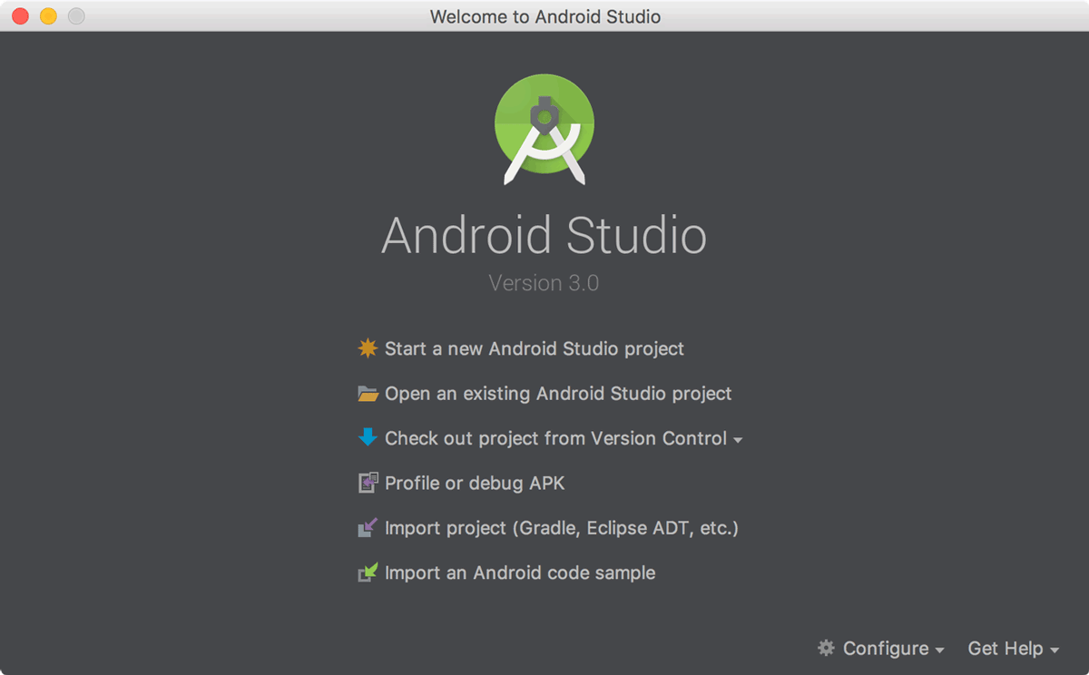
1. In the Welcome to Android Studio window, click Start a new Android Studio project. Or if you have a project opened, select File > New Project.

Slide 46
2. In the Create New Project window, enter the following values:
- Application Name: "My First App"
- Company Domain: "example.com“
You might want to change the project location. Also, if you want to write a Kotlin app, check the Include Kotlin support checkbox. Leave the other options as they are.
3. Click Next.
4. In the Target Android Devices screen, keep the default values and click Next.
5. In the Add an Activity to Mobile screen, select Empty Activity and click Next.
6. In the Configure Activity screen, keep the default values and click Finish.

Slide 47
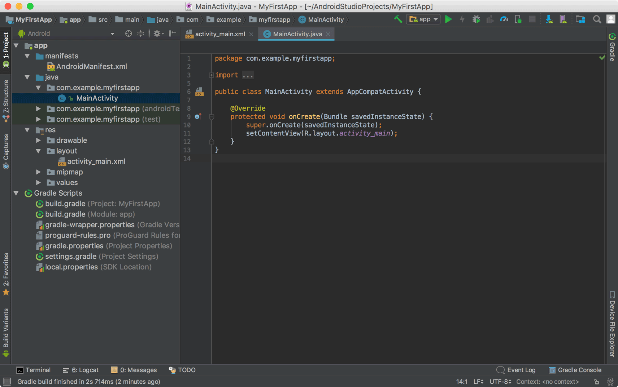
After some processing, Android Studio opens the IDE.

Slide 48
First, be sure the Project window is open (select View > Tool Windows > Project) and the Android view is selected from the drop-down list at the top of that window. You can then see the following files: app > java > com.example.myfirstapp > MainActivity
This is the main activity (the entry point for your app). When you build and run the app, the system launches an instance of this Activity and loads its layout. app > res > layout > activity_main.xml
This XML file defines the layout for the activity's UI. It contains a TextView element with the text "Hello world!". app > manifests > AndroidManifest.xml
The manifest file describes the fundamental characteristics of the app and defines each of its components.
Gradle Scripts > build.gradle
You'll see two files with this name: one for the project and one for the "app" module. Each module has its own build.gradle file, but this project currently has just one module. You'll mostly work with the module's build.gradle file to configure how the Gradle tools compile and build your app.

Slide 49
Run Your App

Slide 50
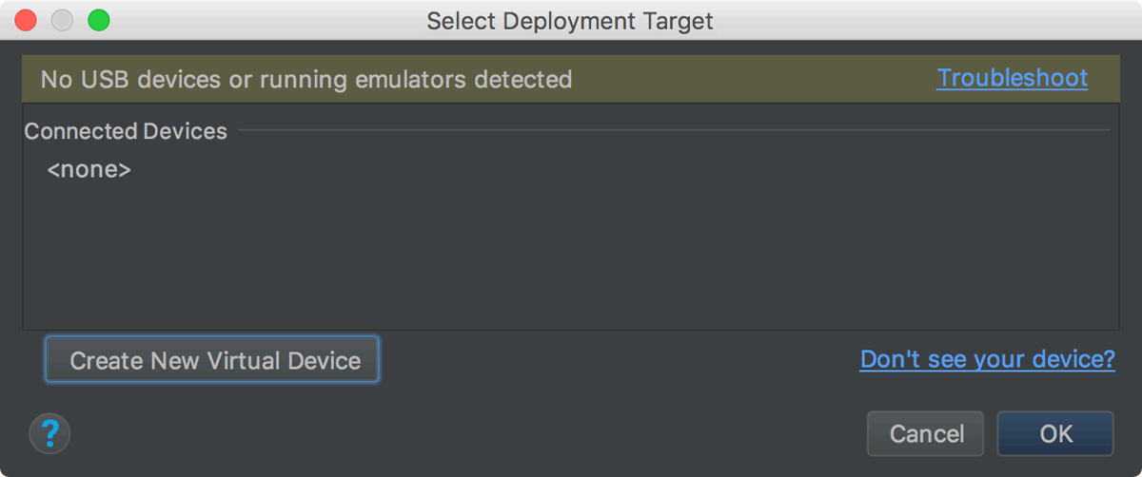
Run on an emulator
Run the app on an emulator as follows:
1. In Android Studio, click the app module in the Project window and then select Run > Run (or click Run in the toolbar).
2. In the Select Deployment Target window, click Create New Virtual Device.
3. In the Select Hardware screen, select a phone device, such as Pixel, and then click Next.
4. In the System Image screen, select the version with the highest API level. If you don't have that version installed, a Download link is shown, so click that and complete the download.
5. Click Next.
6. On the Android Virtual Device (AVD) screen, leave all the settings alone and click Finish.
7. Back in the Select Deployment Target dialog, select the device you just created and click OK.
Android Studio installs the app on the emulator and starts it. You should now see "Hello World!" displayed in the app running on the emulator.

Slide 51
Run on a real device
Set up your device as follows:
1. Connect your device to your development machine with a USB cable. If you're developing on Windows, you might need to install the appropriate USB driver for your device.
2. Enable USB debugging in the Developer options as follows.
First, you must enable the developer options:
a. Open the Settings app.
b. (Only on Android 8.0 or higher) Select System.
c. Scroll to the bottom and select About phone.
d. Scroll to the bottom and tap Build number 7 times.
e. Return to the previous screen to find Developer options near the bottom.
Open Developer options, and then scroll down to find and enable USB debugging.

Slide 52
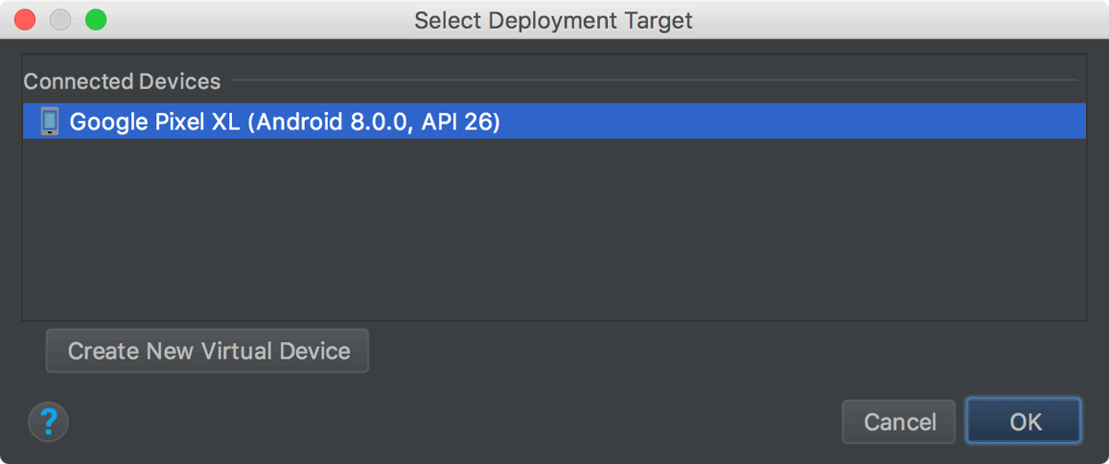
Run the app on your device as follows:
1. In Android Studio, click the app module in the Project window and then select Run > Run (or click Run in the toolbar).
2. In the Select Deployment Target window, select your device, and click OK.
Android Studio installs the app on your connected device and starts it. You should now see "Hello World!" displayed in the app running on your device

